Slide 1
Topic:
Mapping constraints and
Relationship of Higher Degree

Slide 2
Mapping Constraints
A mapping constraint is a data constraint that expresses the number of entities to which another entity can be related via a relationship set.
It is most useful in describing the relationship sets that involve more
than two entity sets.
For binary relationship set R on an entity set A and B, there are four
possible mapping cardinalities. These are as follows:
One to one (1:1)
One to many (1:M)
Many to one (M:1)
Many to many (M:M)

Slide 3
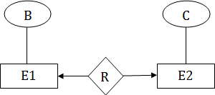
One-to-one
In one-to-one mapping, an entity in E1 is associated with at most one entity in E2, and an entity in E2 is associated with at most one entity in E1.

Slide 4
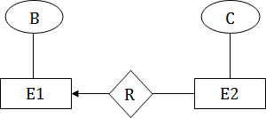
One-to-many
In one-to-many mapping, an entity in E1 is associated with any number of entities in E2, and an entity in E2 is associated with at most one entity in E1.

Slide 5
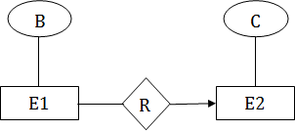
Many-to-one
In one-to-many mapping, an entity in E1 is associated with at most one entity in E2, and an entity in E2 is associated with any number of entities in E1.

Slide 6
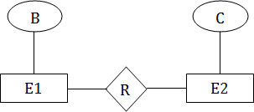
Many-to-many
In many-to-many mapping, an entity in E1 is associated with any number of entities in E2, and an entity in E2 is associated with any number of entities in E1.

Slide 7
Mapping CardinalityConstraints
◻ Express the number of entities to which another entity associated via a relationship set.
◻ Most useful in describing binary relationship sets.
◻ For a binary relationship set the mapping cardinality one of the following types:
○ One to one
○ One to many
○ Many to one
○ Many to many
can be
must be

Slide 8
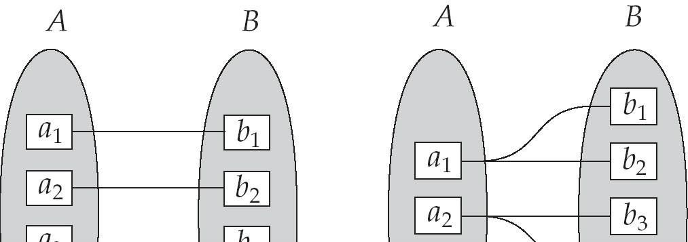
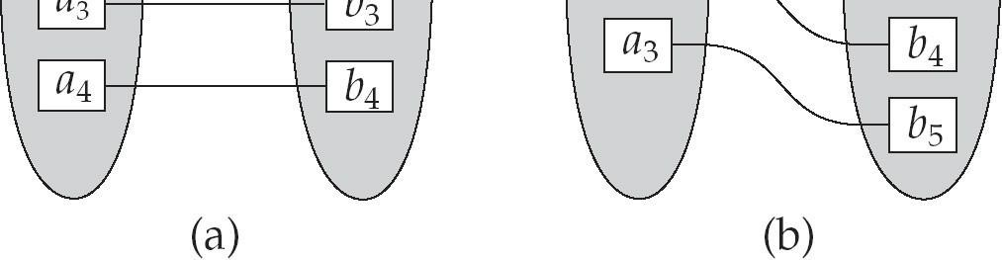
Mapping Cardinalities
One to one
One to many

Slide 9
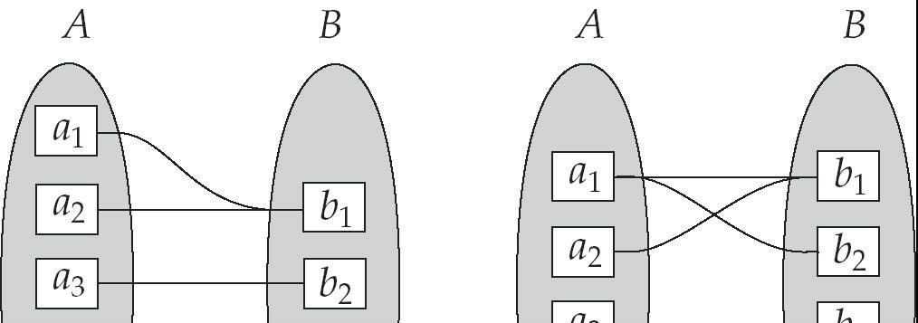
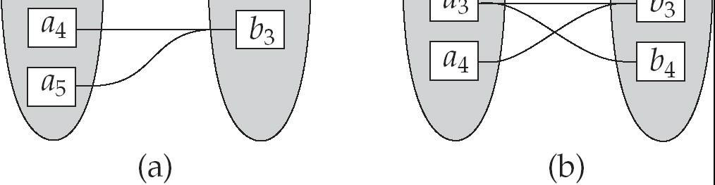
Mapping Cardinalities
Many to one
Many to many

Slide 10
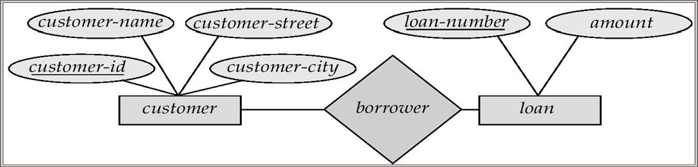
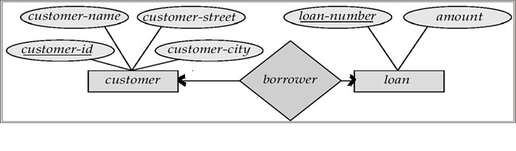
Cardinality Constraints
◻ We express cardinality constraints by drawing either a directed line (→), signifying “one,” or an undirected line (—), signifying “many,” between the relationship set and the entity set.
◻ One-to-one relationship:
○ A customer is associated with at most one loan via the relationship borrower
○ A loan is associated with at most one customer via borrower

Slide 11
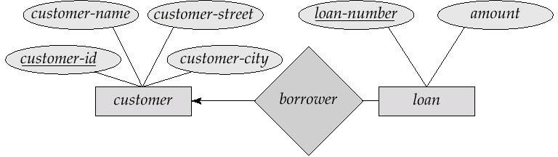
One-To-Many Relationship
◻ In the one-to-many relationship a loan is associated with at most one customer via borrower, a customer is associated with several (including 0) loans via borrower

Slide 12
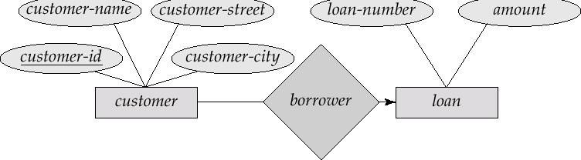
Many-To-One Relationships
◻ In a many-to-one relationship a loan is associated with several (including 0) customers via borrower, a customer is associated with at most one loan via borrower

Slide 13
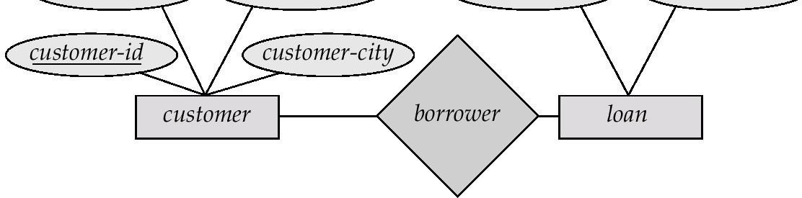
Many-To-Many Relationship
◻ A customer is associated with several (possibly 0) loans via borrower
◻ A loan is associated with several (possibly 0)
customers via borrower

Slide 14
Relationships of Higher Degree
Relationship types of degree 2 are called binary.
Relationship types of degree 3 are called ternary and of
degree n are called n-ary.
In general, an n-ary relationship is not equivalent to n binary relationships.
Constraints are harder to specify for higher-degree relationships (n > 2) than for binary.

Slide 15
Discussion of n-ary relationships (n > 2)
In general, 3 binary relationships can represent different information
than a single ternary relationship.
If needed, the binary and n-ary relationships can all be included in the schema design.
In some cases, a ternary relationship can be represented as a weak entity if the data model allows a weak entity type to have multiple identifying relationships (and hence multiple owner entity types).
If a particular binary relationship can be derived from a higher- degree relationship at all times, then it is redundant.

Slide 16
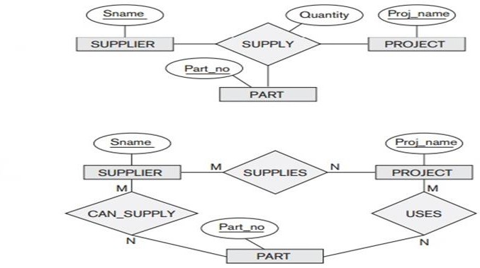
Example of n-ary relationships (n > 2)

Slide 17
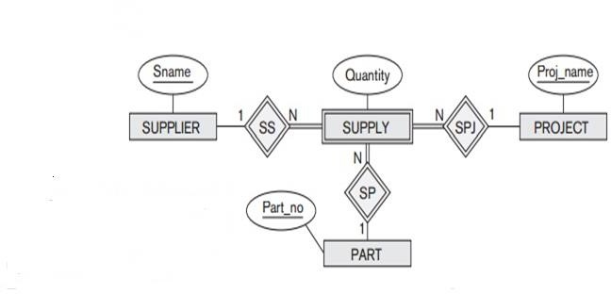
Example of n-ary relationships (n > 2)

Slide 18
Thank You

